Slide 1
Logbook - July
Get access to the code

Slide 2
Settings
Input: Real_Data_with_LPF1
10000 data points
1Vpp, 0.5V offset
24414kHz
MCU:
Fs: 2000Hz ->timer used
Hold time: 0.5ms -> 1 sample time
Detection time: 0.5ms -> 1 sample time
Update period: 10ms -> 20 sample time
Mean Buffer Length: 16
Thresholding Buffer Length: 64
Thresholding Parameters: 25

Slide 3
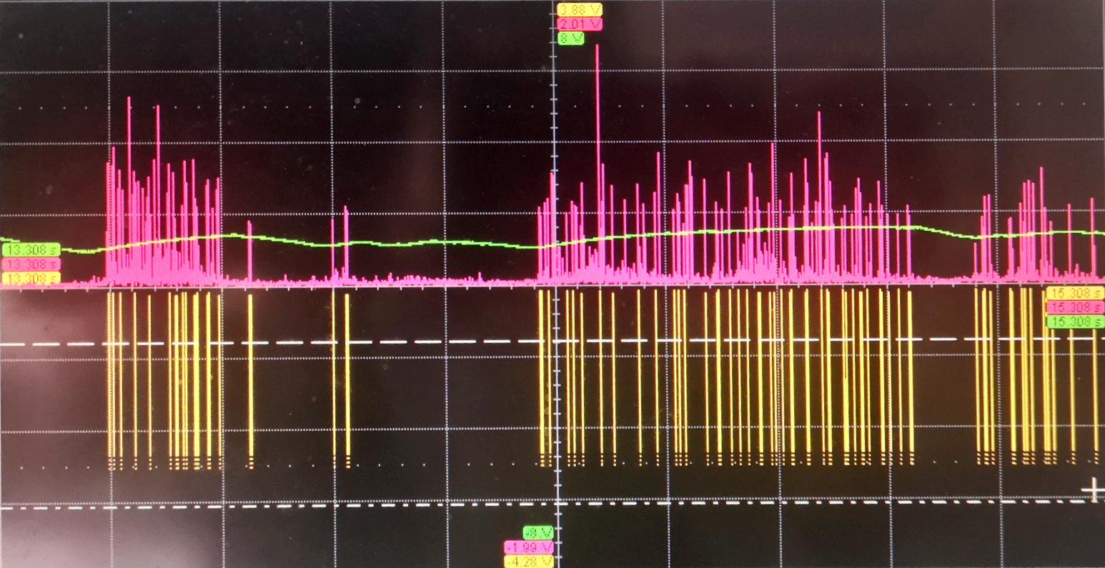
Detection Results
Pink: Emphasised data
Green: Threshold (smoothed)
Yellow: Detected Spike Indication

Slide 4
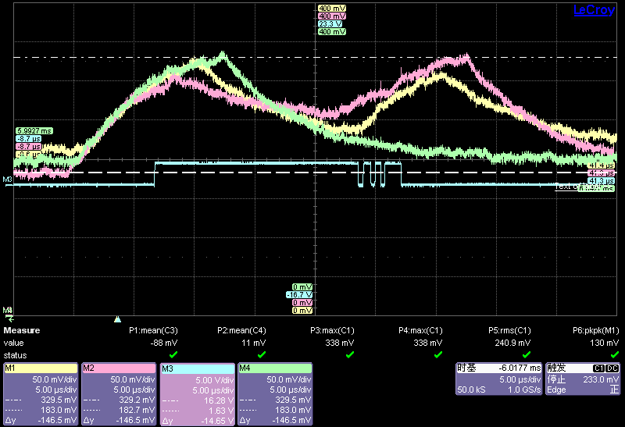
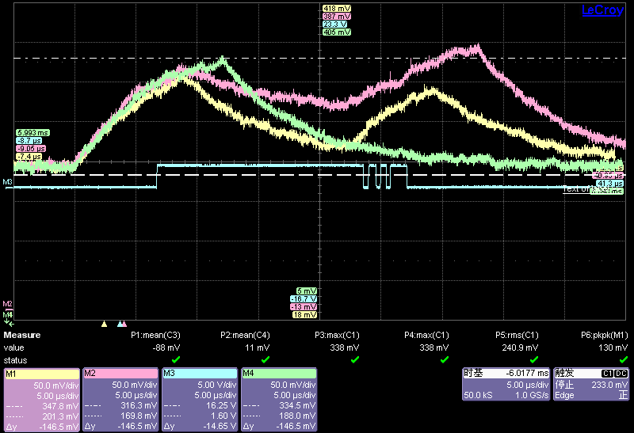
Power Consumption - Voltage crosses 20R Resistor:
Pink: Total
Yellow: Only sampling
Green: Only sampling timer
Blue: Event indicator
Pink: Total
Yellow: Only sampling
Green: Only sampling timer
Blue: Event indicator
Sampling Only
Processing
Noise Ground aligned
Absolute aligned
Events: ADC read, Subtract Mean, Emphasis, Thresholding
- related to the pink line.
Total
Sampling with Sampling Timer

Slide 5
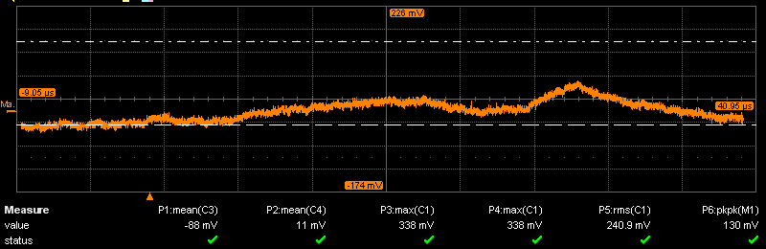
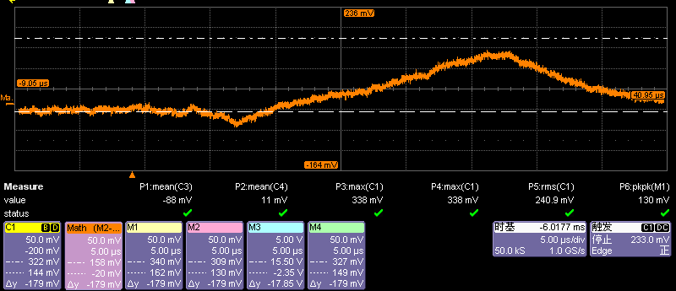
Total - Sampling
Difference:
10.42uW
Difference
of
Signals
Total – Sampling timer
Difference:
71.56uW

Slide 6
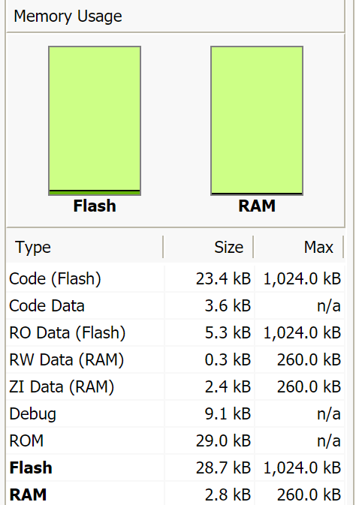
Memory Usage

